Slide 1
Physical Computing

Slide 2
Breadboard

Slide 3
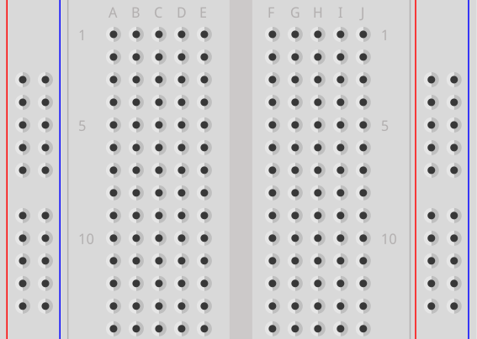
Breadboard
Power rails
Power rails
Terminal strips
Power rails:
Vertical ↕
Terminal strips:
Horizontal ↔
Notes:
Power rails also known as bus strips

Slide 4
Raspberry Pi Pico

Slide 5
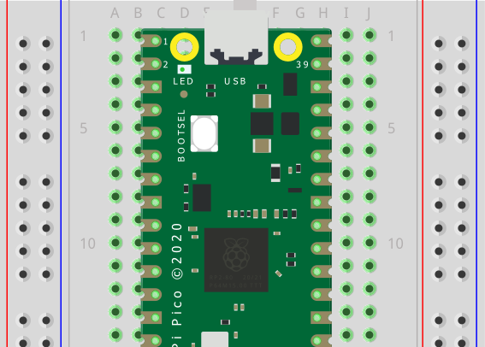
Pico Internal LED
USB connector
LED

Slide 6
Light Emitting Diode

Slide 7

LED
Flat side
Anode
(Long leg)
Cathode
(Short leg)
-Ve
(0V)
+Ve
(5V)

Slide 8

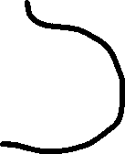

LED Circuit
Flat side
+Ve
-Ve
Resistor
Power
+Ve
-Ve
LED – One way
Resistor – Any way
Notes:
Resistor = (Supply voltage – LED Forward voltage) / LED Forward current
Resistor can be larger, not smaller, then calculated size

Slide 9
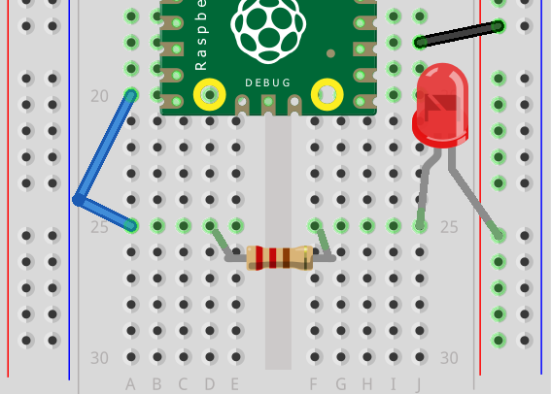
Pico External LED
GND
(0V)
GP15
(3.3V)

